Slide 1
UIU
United International University
CENTRAL LIBRARY
SMART LIBRARY PLATFORM
WEB PROJECT
Search the shelves.
Borrow in one step.
Smart Library
Platform
A discovery and circulation system for the UIU Central Library.
One catalogue for print, e-books, journals and UIU theses — with recommendations drawn only from titles the library actually holds.
PRESENTED BY
Mahedi Hasan Sorol · Mostafizur Rahman Murad
Md Minhazul Hoque · Rafsan Hossen Basunia
Team Ascent

Slide 2
01 · PROJECT DESCRIPTION
What we are building
A single place for UIU students to find, borrow and keep track of everything the library holds — print, e-books, journals and theses.
The UIU Central Library holds over 42,000 titles, but students still search a catalogue that does not tell them whether a copy is on the shelf, where to find it, or what to read next.
Smart Library Platform replaces that with one discovery layer: live availability down to the individual copy, one-step reserving, and recommendations drawn only from titles the library actually owns.
IN SCOPE
01
Unified catalogue search
Print, e-books, journals, UIU theses
02
Circulation self-service
Reserve, renew, hold queues, returns
03
Personal recommendations
From borrowing history and interests
42,180
61,904
4,880
04
Facilities & account
Study rooms, fines, notifications
TITLES HELD
COPIES
STUDENTS
05
Staff back office
Catalogue admin, circulation desk, reports
PROJECT DESCRIPTION
Member 1 · 01 / 12

Slide 3
02 · PROBLEM & USERS
Who it is for
Three roles, one system — each sees only what it needs.
STUDENT
FACULTY
LIBRARY STAFF
Undergraduate & postgraduate
Teaching staff
Circulation & technical services
Search, borrow, renew, book a study room, track fines and get recommendations. 5 items for 14 days.
Everything a student can do, plus course reserves and longer loan periods for teaching material.
Issue and accept returns at the desk, manage the catalogue, action hold queues and read reports.
THE PROBLEM TODAY
No live availability — students walk to the shelf to find out.
No way to reserve; first to arrive wins.
Nothing suggests what to read next.
Fines and due dates are only visible at the desk.
PROBLEM & USERS
Member 1 · 02 / 12

Slide 4
03 · ARCHITECTURE
How the pieces fit
A single Next.js application talking to a Node API layer, with Supabase providing Postgres, auth and file storage.
CLIENT
API
DATA
Next.js (React)
Node.js
Supabase
App Router pages
→
REST route handlers
→
Postgres catalogue
Server components
Search & ranking
Auth & RLS policies
Tailwind UI layer
Business rules
Storage for covers
REQUEST FLOW
Student searches → Next.js server component calls the Node API → API queries Postgres for copies and availability → ranked results return with live shelf status → reserve writes a hold row and notifies the desk.
ARCHITECTURE
Member 1 · 03 / 12

Slide 5
04 · TOOLS & TECHNOLOGY
What we are building it with
Chosen for speed of delivery and because the whole team can work in one language across the stack.
FRONTEND
App Router, server components and file-based routing. React keeps the component model consistent with the prototype we designed.
Next.js · React
BACKEND
REST API handling search ranking, circulation rules, hold queues and the recommendation engine.
Node.js
DATABASE
Relational catalogue with row-level security. Supabase Auth handles UIU single sign-on; Storage holds cover art.
Supabase · Postgres
TOOLING
Typed end to end, styled from design tokens, with the interface prototyped in Figma first.
TypeScript · Tailwind · Figma
TOOLS & TECHNOLOGY
Member 2 · 04 / 12

Slide 6
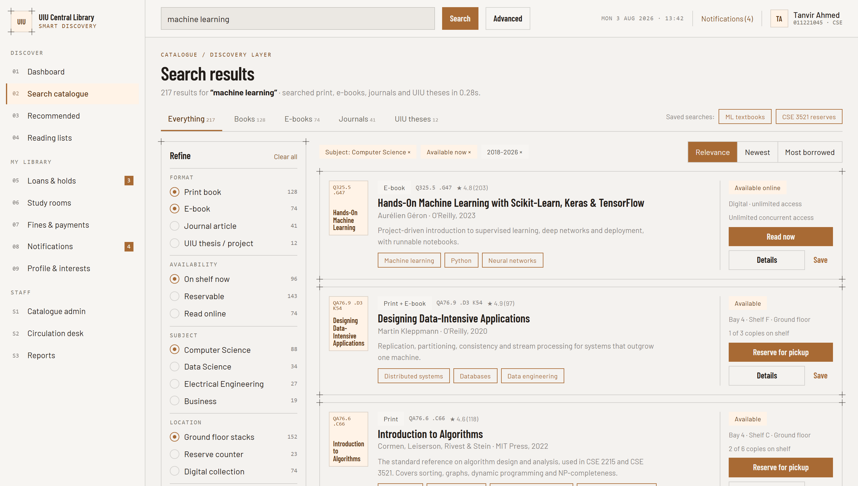
05 · FEATURE
Sign in & search the catalogue
ONE SIGN-ON, ONE CATALOGUE
01
UIU single sign-on
Same credentials as UCAM — student, faculty or staff
02
Search everything
Print, e-books, journals and UIU theses in one query
03
Filter as you go
Format, availability, subject, location, language, year
04
Live shelf status
Every result shows copies free and where they sit
05
Saved searches
Keep course reserve lists one click away
AUTHENTICATION & SEARCH
Member 2 · 05 / 12

Slide 7
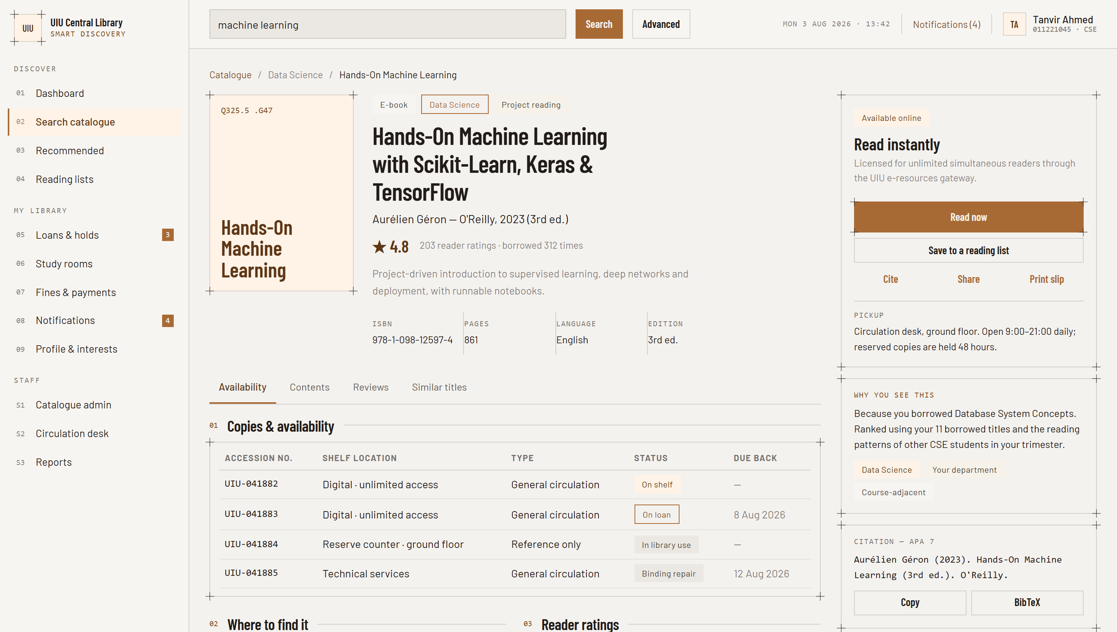
06 · FEATURE
Book detail & reserving
COPY-LEVEL DETAIL
01
Every copy listed
Accession number, shelf, type and due-back date
02
Shelf map
Highlights the exact bay so you can walk straight to it
03
One-step reserve
Held 48 hours at the desk, or read instantly if digital
04
Reader ratings
Distribution and reviews from other UIU students
05
Ready-made citation
APA 7 and BibTeX, copied in one click
BOOK DETAIL & RESERVING
Member 2 · 06 / 12

Slide 8
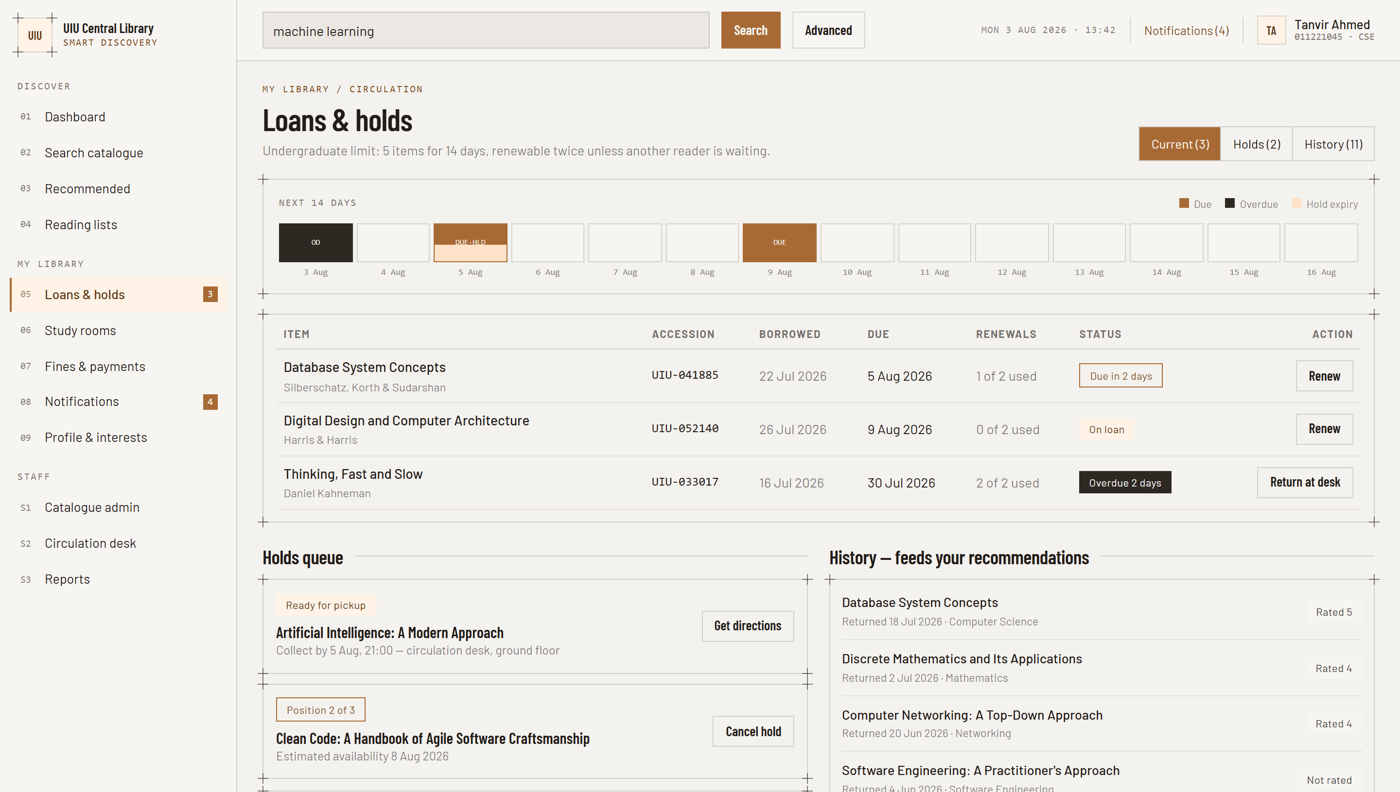
07 · FEATURE
Loans, holds & renewals
NEVER MISS A DUE DATE
01
14-day timeline
Due dates, overdue items and hold expiry at a glance
02
Renew in place
Twice per item, unless another reader is waiting
03
Hold queue position
See exactly where you are and the estimated date
04
Pickup reminders
Alerts when a reserved copy reaches the desk
05
Borrowing history
Feeds recommendations; clearable any time
LOANS & HOLDS
Member 3 · 07 / 12

Slide 9
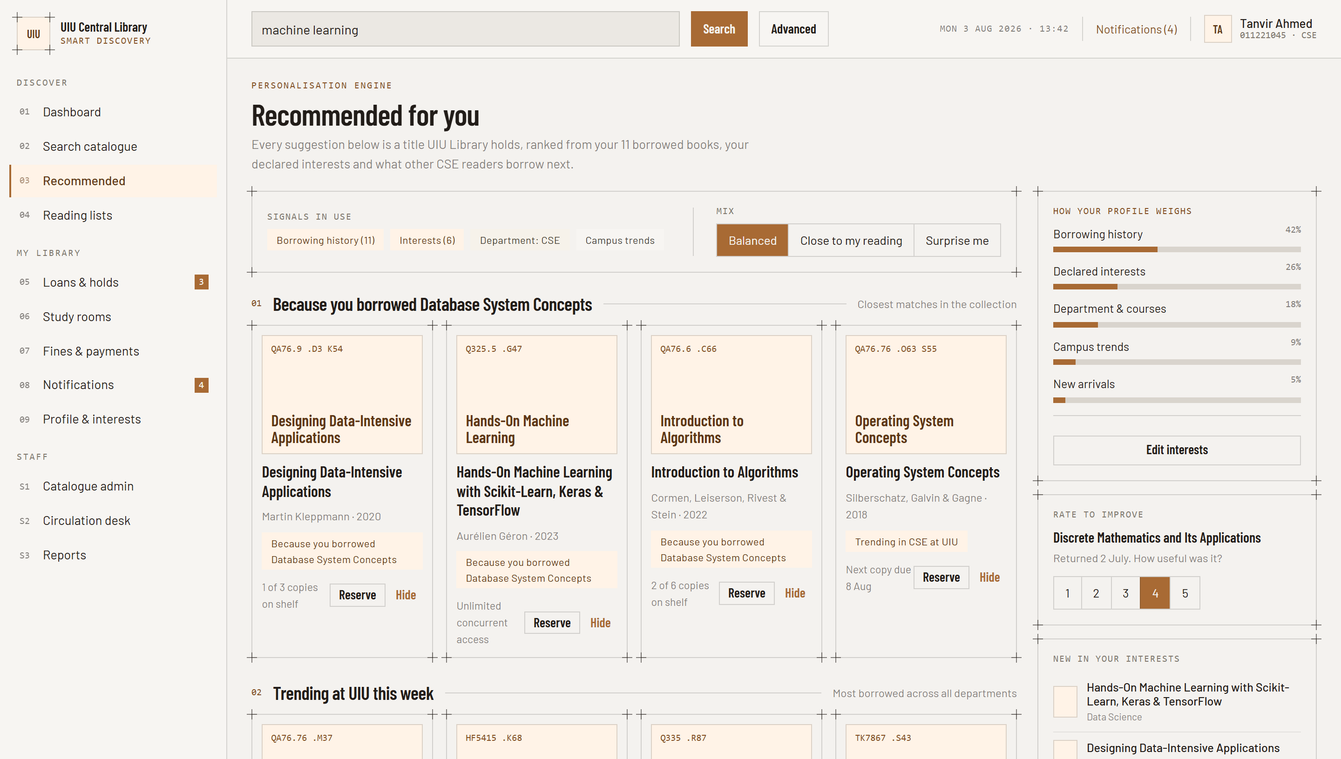
08 · FEATURE
Personal recommendations
ONLY WHAT WE ACTUALLY HOLD
01
Four ranking signals
History 42%, interests 26%, courses 18%, trends 9%
02
Grouped by reason
“Because you borrowed…”, trending, similar readers
03
Always explained
Every suggestion says why it is being shown
04
Tune the mix
Balanced, close to my reading, or surprise me
05
Rate to improve
Returned books feed straight back into ranking
RECOMMENDATIONS
Member 3 · 08 / 12

Slide 10
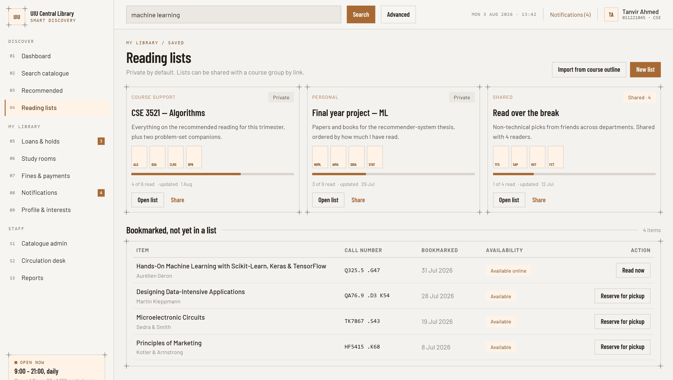
09 · FEATURE
Reading lists & bookmarks
ORGANISE BY COURSE
01
Build your own lists
Course reading, thesis sources, holiday picks
02
Import a course outline
Pulls the reserve list for an enrolled course
03
Share by link
Private by default; share with a course group
04
Track progress
See how much of each list you have read
05
Quick bookmarks
Save now, sort into a list later
READING LISTS
Member 3 · 09 / 12

Slide 11
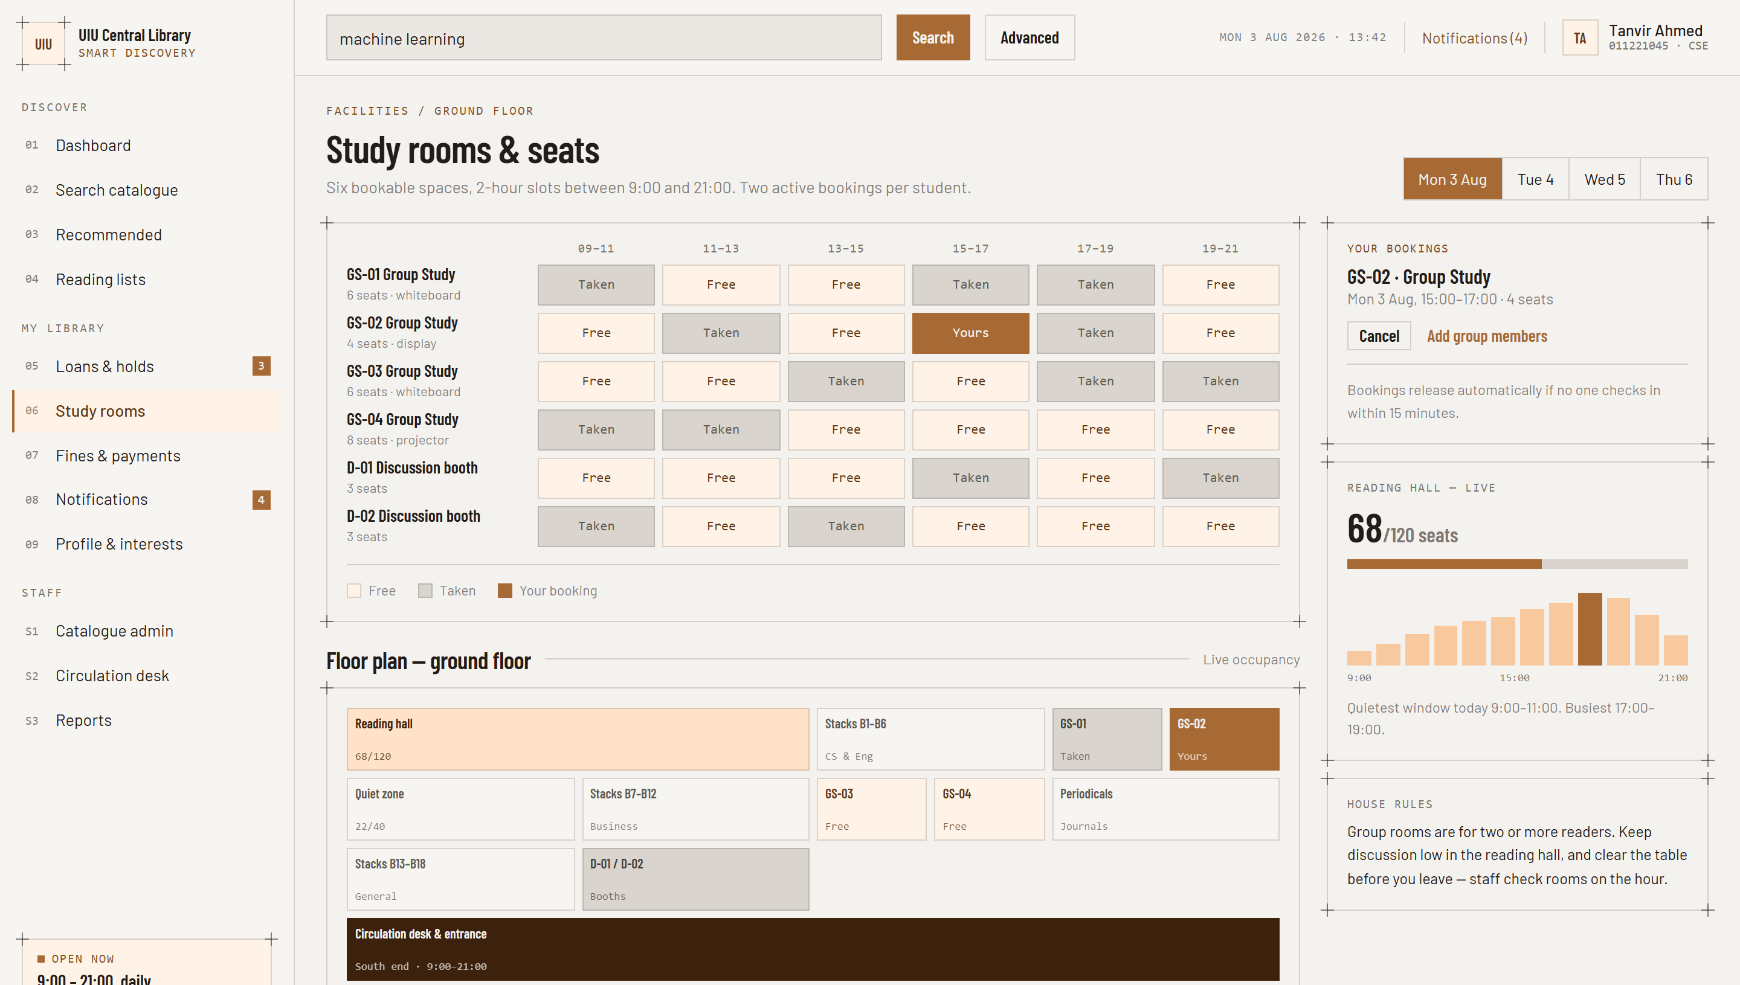
10 · FEATURE
Study rooms & live occupancy
BOOK BEFORE YOU WALK OVER
01
Six bookable spaces
Two-hour slots between 9:00 and 21:00
02
Live seat count
68 of 120 seats in the reading hall right now
03
Floor plan
Shows zones, stacks and which rooms are free
04
Busiest-hour chart
Plan around the 17:00–19:00 peak
05
Auto-release
Slots free up if nobody checks in within 15 minutes
STUDY ROOMS
Member 4 · 10 / 12

Slide 12
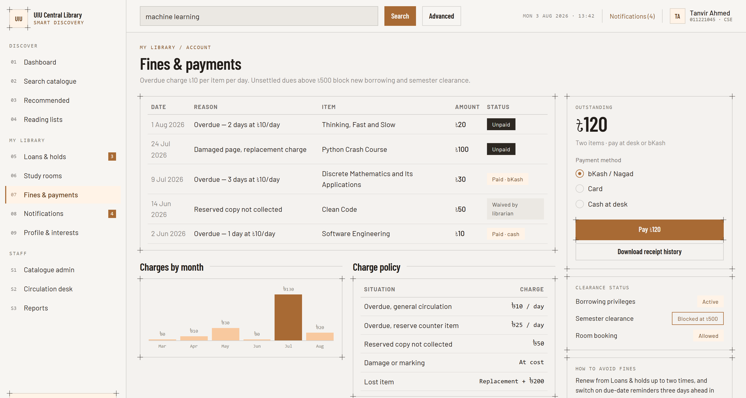
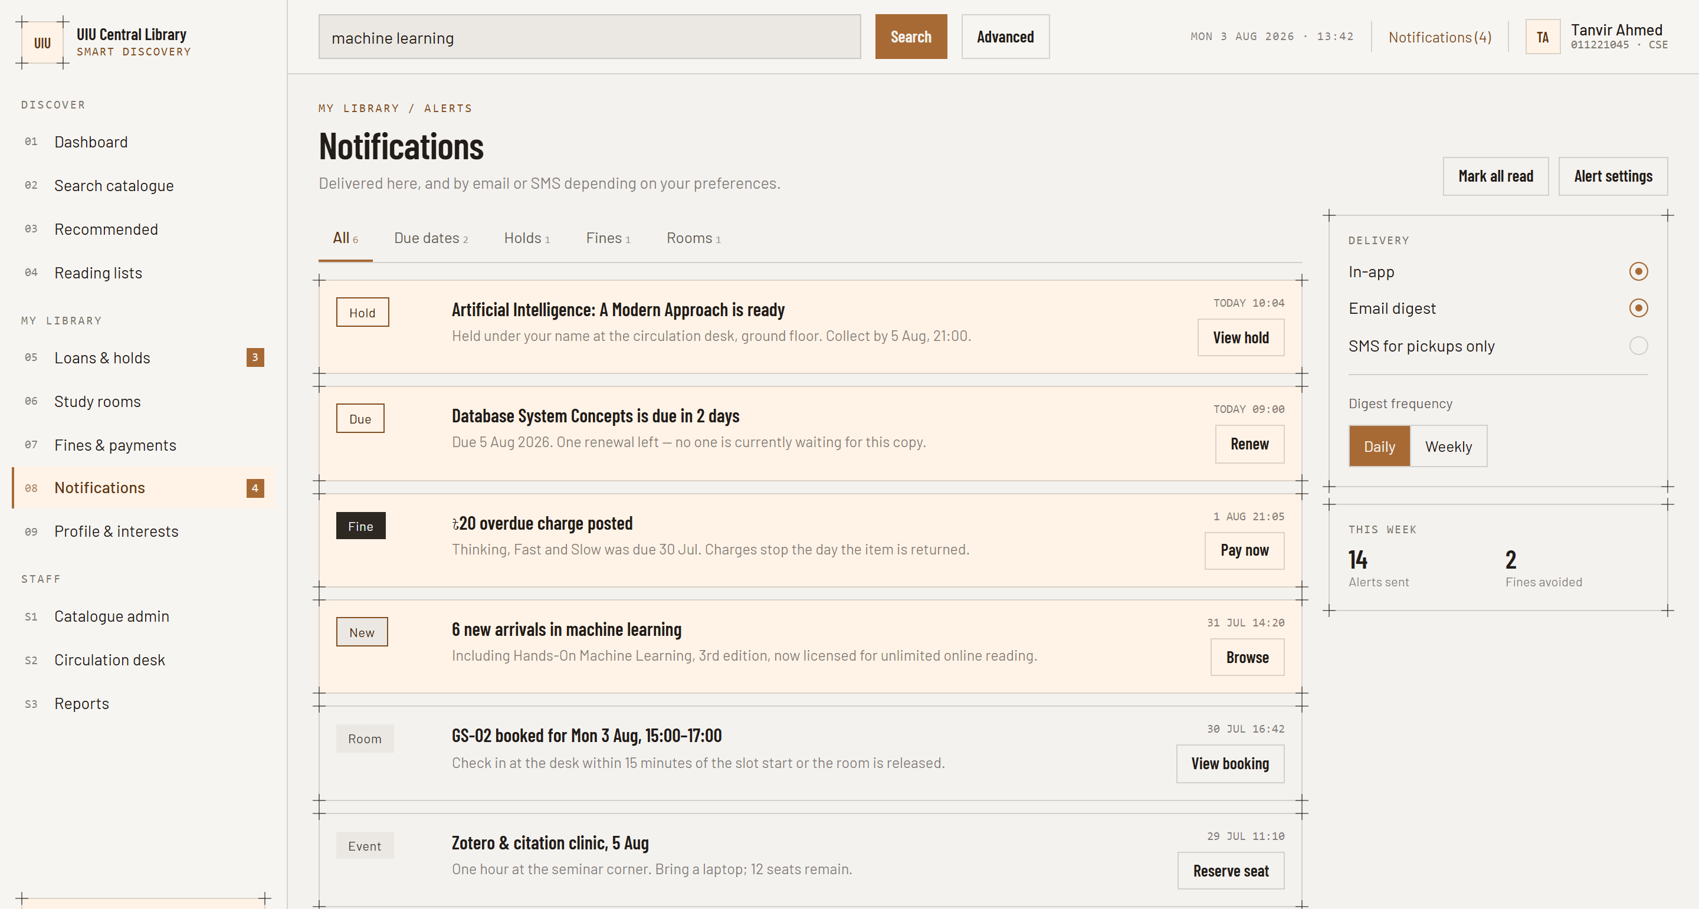
11 · FEATURE
Fines, payments & notifications
TRANSPARENT CHARGES
PAY FROM ANYWHERE
ALERTS THAT PREVENT FINES
৳10 per item per day, shown the moment it is posted. Full ledger of every charge, payment and waiver.
bKash, Nagad or card — no queue at the desk. Clearance status shows what is blocking semester sign-off.
Due-date reminders three days ahead, pickup alerts and new-arrival notices by app, email or SMS.
FINES & NOTIFICATIONS
Member 4 · 11 / 12

Slide 13
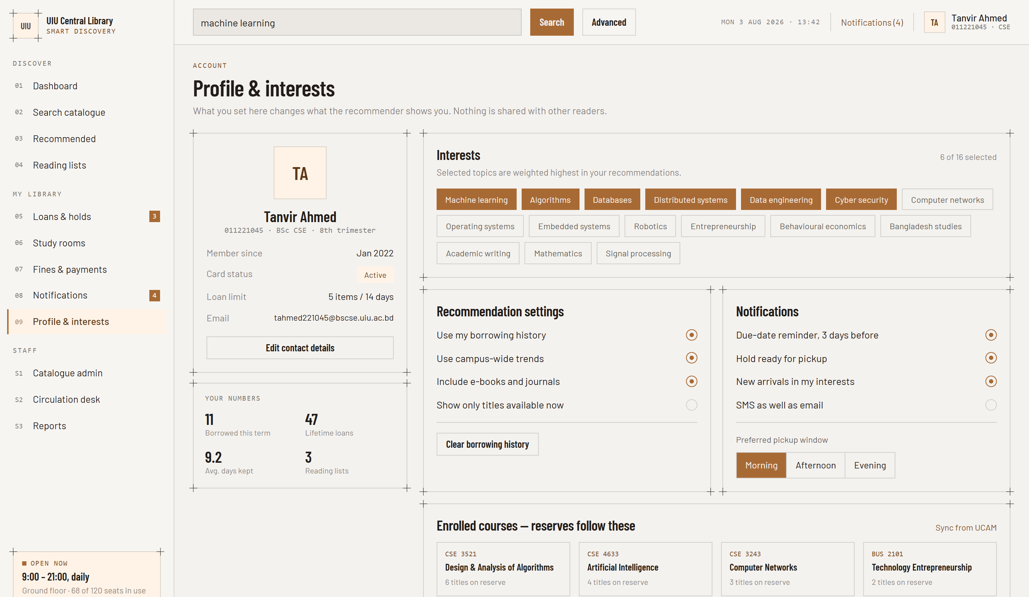
12 · FEATURE & NEXT STEPS
Profile, privacy & what comes next
YOU CONTROL THE RANKING
01
16 interest topics
Pick what gets weighted highest for you
02
Recommendation switches
Turn history or campus trends off entirely
03
Clear your history
Nothing is shared with other readers
04
Course sync
Reserves follow the courses you are enrolled in
ROADMAP
Mobile app with barcode scanning · offline e-book reader · inter-library loans with other Dhaka universities.
PROFILE & ROADMAP
Member 4 · 12 / 12

Slide 14
SMART LIBRARY PLATFORM
Thank you
Questions welcome.
Team Ascent

